Slide 1

Beyond
Square
CB013366
M.G LAKSHAN NIROSHAN
DECISION ANALYTICS I
ASSIGNMENT I
Footage
Uncovering Hidden Value Drivers in Rental Pricing

Slide 2
Beyond
Square
Footage
Uncovering Hidden Value Drivers in Rental Pricing

Slide 3
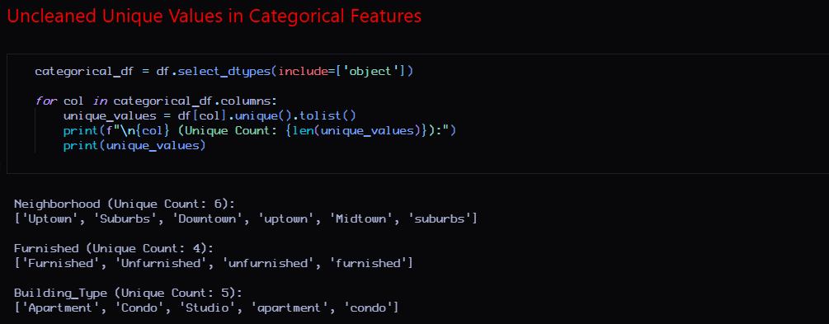
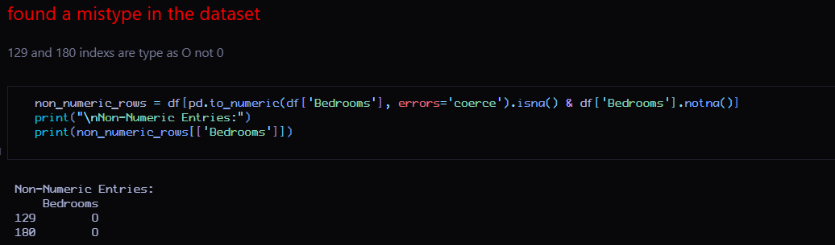
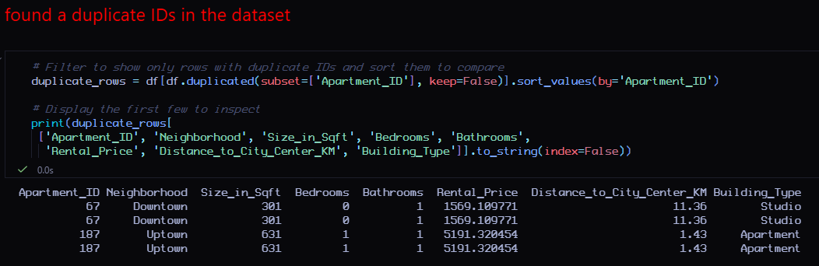
Data Cleaning
Beyond
Square
Footage
Uncovering Hidden Value Drivers in Rental Pricing

Slide 4
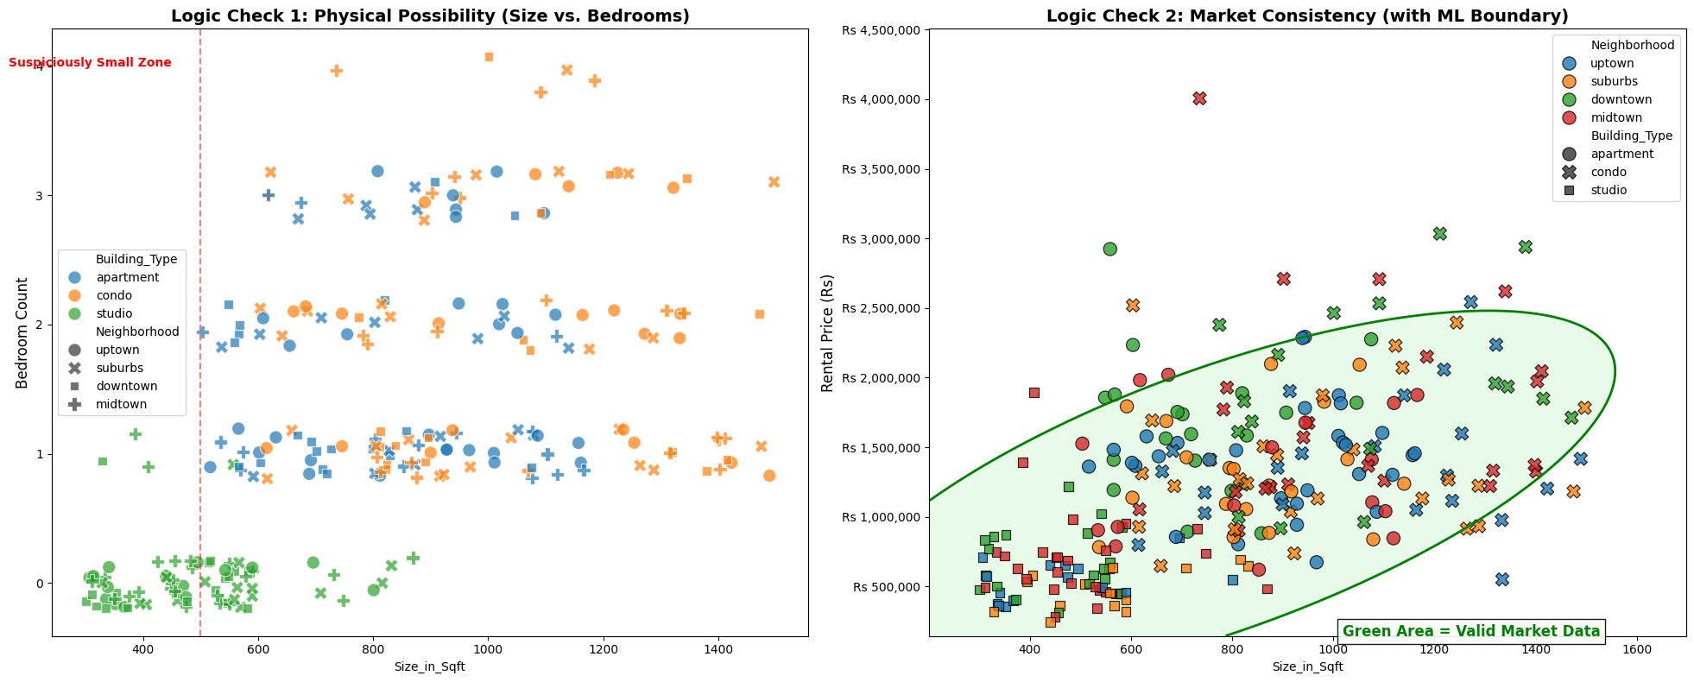


Advanced Data Cleaning
Diagnostic Dashboard
Multivariate Anomaly Detection.
Elliptic Envelope

Slide 5
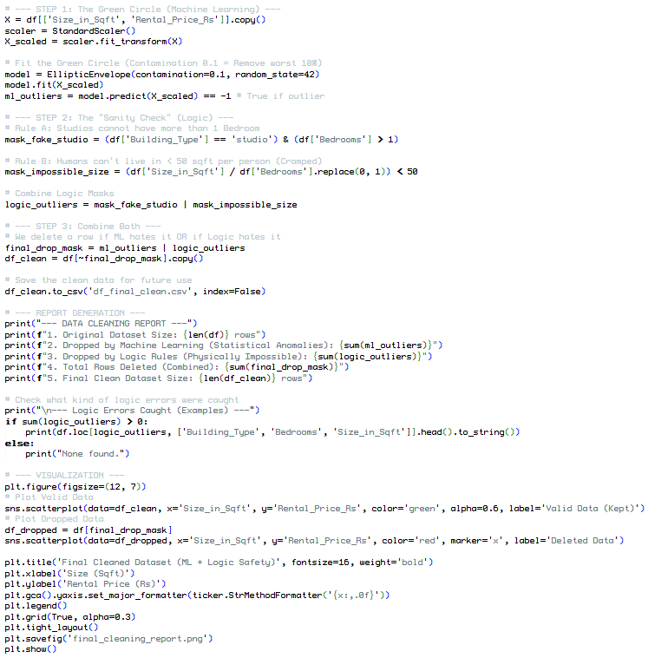
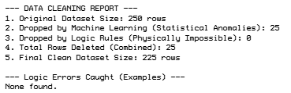
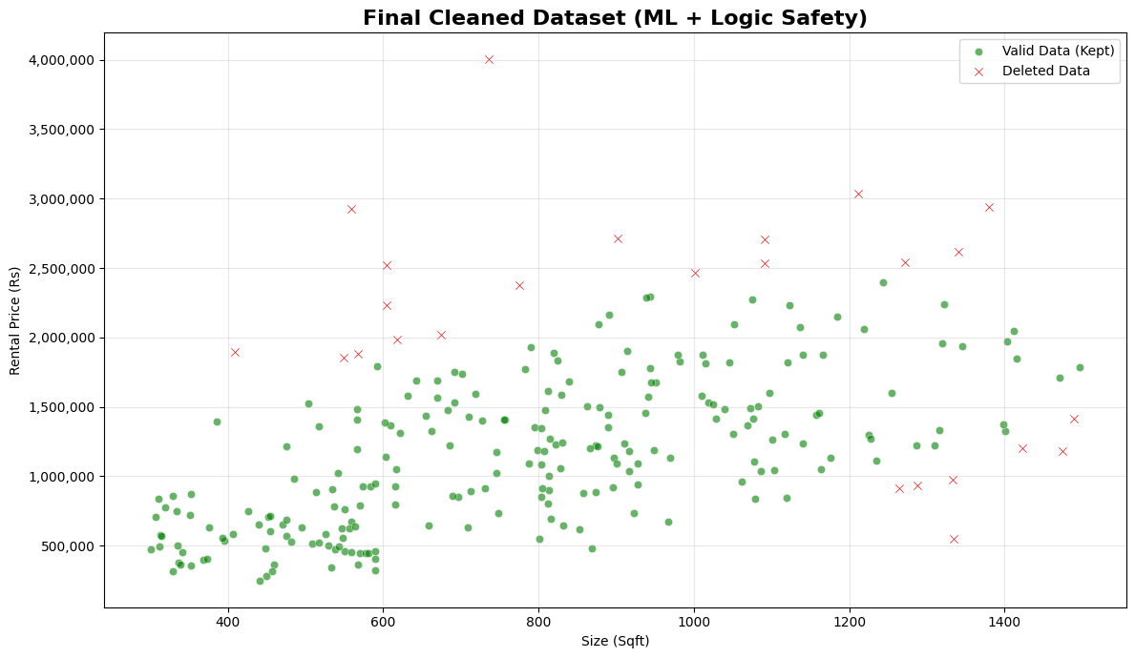
Real Life Analysis
To predict future market trends, our data must represent reality.
Notes:
1. The Principle of "Garbage In, Garbage Out" The purpose of this analysis is to build a reliable model that predicts future rental trends in Colombo. Data analytics relies on the principle that input data must reflect reality. If we train a model on erroneous data ("noise"), it will learn incorrect patterns, causing every future prediction and strategic decision to fail.
2. Distinguishing Errors from Outliers We carefully distinguished between statistical outliers (rare but valid data) and data entry errors (invalid data). The 42 rows removed were identified as errors because they failed basic physical and financial logic:
Physical Impossibility: We found units with 4 bedrooms crammed into 736 sqft, which is physically impossible for a livable apartment.
Market Contradiction: We identified small, unfurnished units (<600 sqft) priced at luxury levels ($5,000+ / 1.5M LKR). In the Colombo market, this price point for such a unit is not a variation; it is a clear error.
3. Conclusion By removing these 42 rows, we prevent the model from learning contradictory rules (e.g., "Small = Expensive"). This ensures our final analysis represents the actual real estate market rather than being skewed by typos and corrupted records.

Slide 6
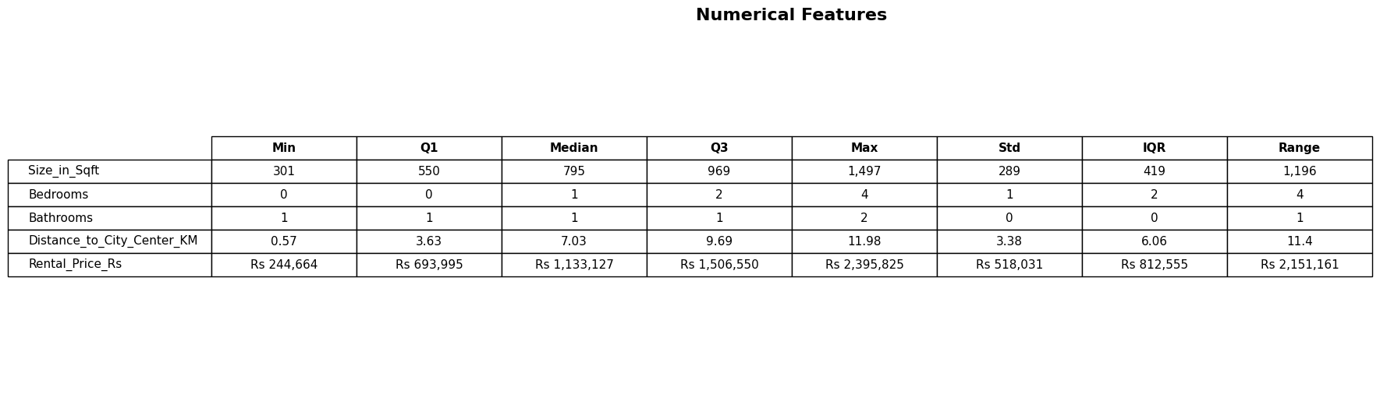
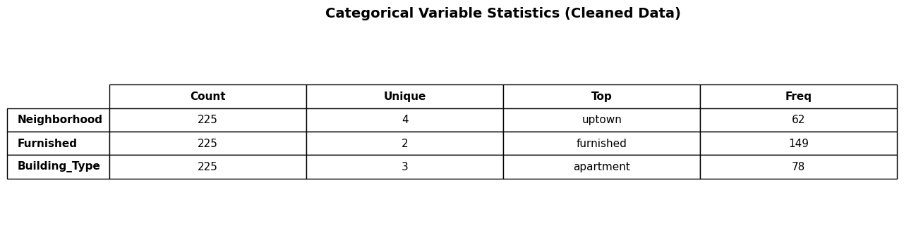
1. Descriptive Statistics
A
a. Numerical Features
b. Categorical Features

Slide 7
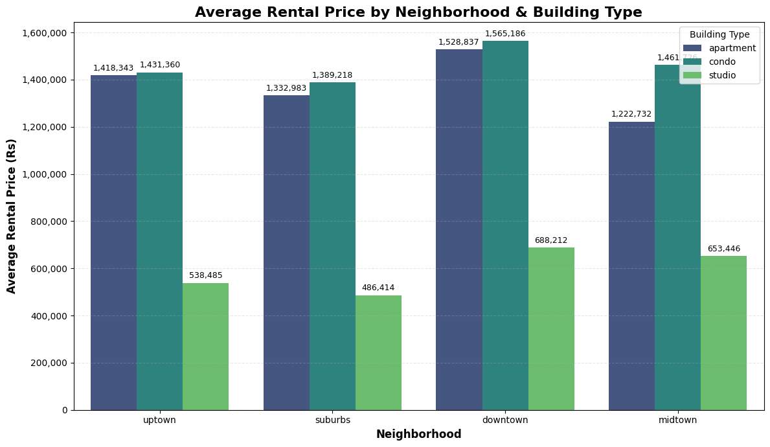
2. Data Visualization
A
B
This bar chart breaks down the rental market by neighborhood and building type. It allows us to compare premiums across neighborhoods. For example, observing how ‘downtown' properties command higher rents than 'Suburbs' for the same building type. It also highlights the price hierarchy, showing where Condos consistently outperform standard Apartments.

Slide 8
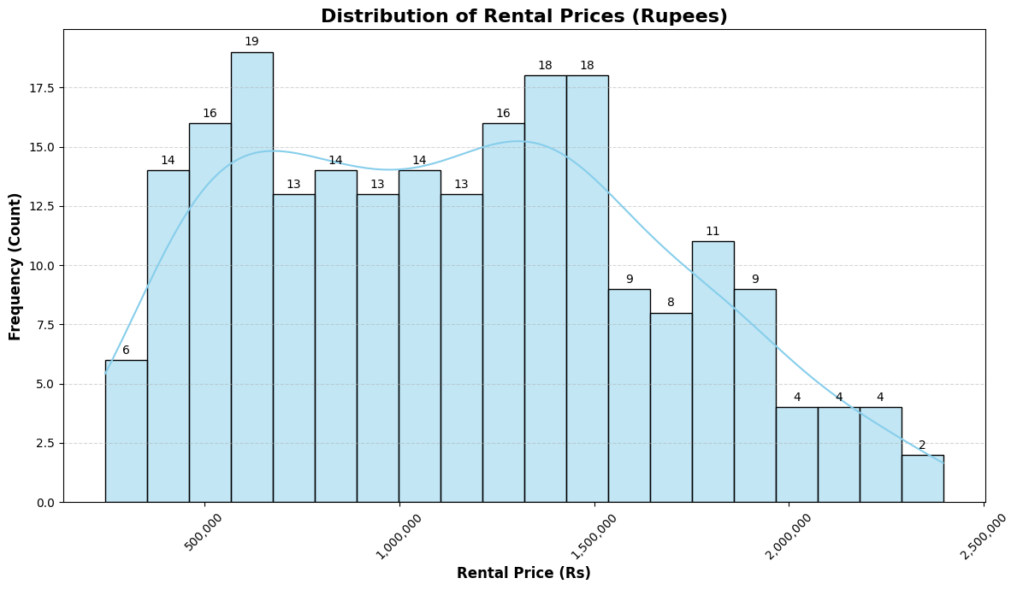
B
C
2. Data Visualization
A
The histogram reveals the shape of the market. The data is right-skewed, meaning most apartments are clustered in the affordable range (the tall bars on the left), while a long tail extends to the right, representing the minority of ultra-luxury properties. This confirms that while the 'average' rent might be high, the 'typical' unit is much cheaper.

Slide 9
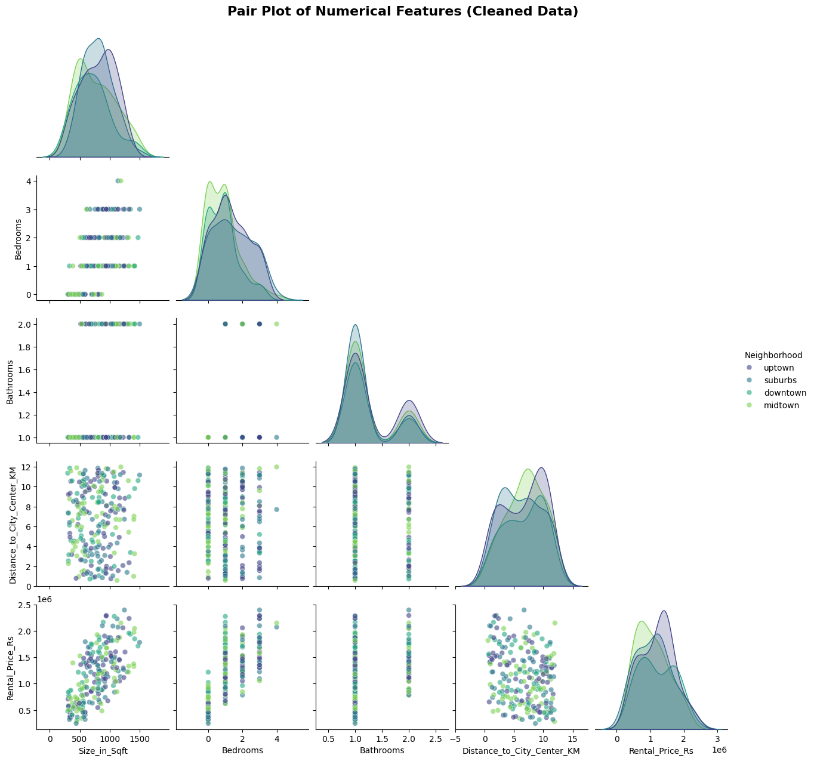
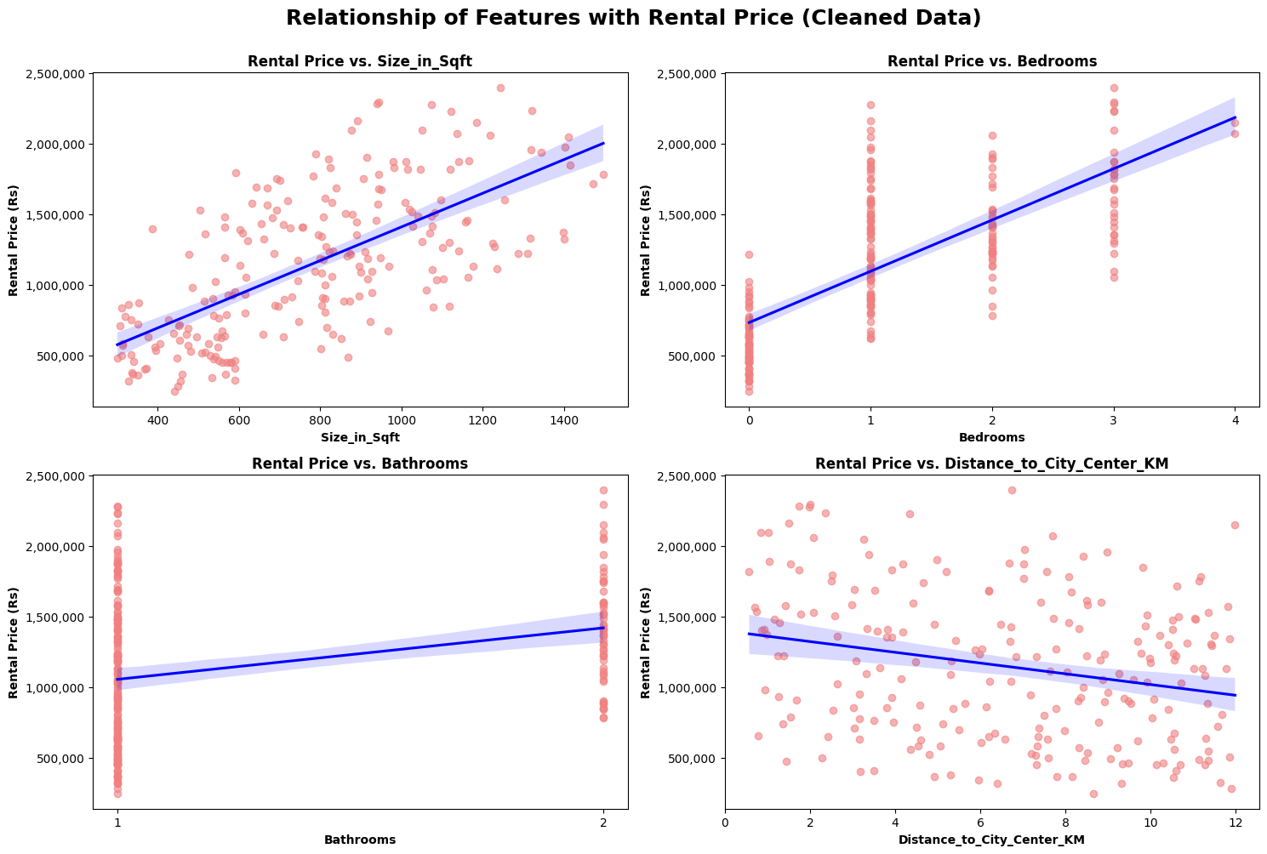
C
D
2. Data Visualization
B
This visual matrix allows us to spot relationships between multiple variables at once. The most distinct pattern is visible in the top-right scatter plots, showing a strong linear relationships between other numerical features and ‘Rental Price’. We also see left scatter plot showing clustering by 'Neighborhood', indicating that location acts as a significant multiplier on these physical traits.

Slide 10
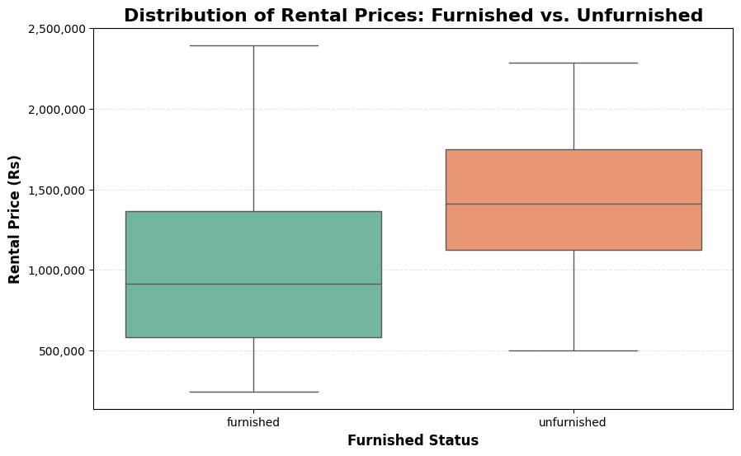
D
C
2. Data Visualization
E
This boxplot reveals a surprising trend. Unfurnished apartments actually command a higher median rental price than Furnished ones. The Furnished category (green) sits lower on the price scale, suggesting that furnished units are often smaller or budget-oriented, while the premium market is dominated by Unfurnished inventory.

Slide 11
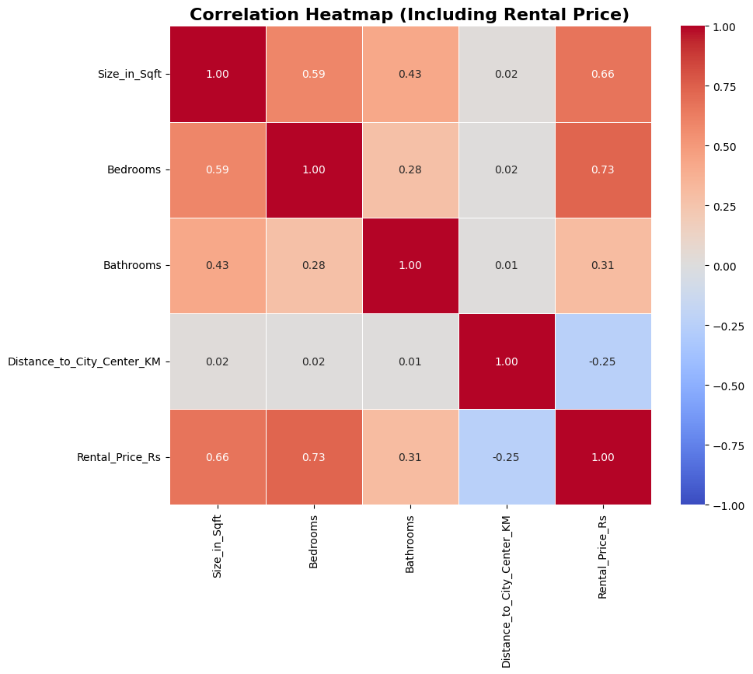
E
D
2. Data Visualization
A
The heatmap quantifies the relationships between our variables. The dark orange square (0.73) between ‘Bedrooms' and 'Rental Price' confirms that bedroom count is the single strongest predictor of rent. Conversely, the negative correlation (blue) for 'Distance to City Center' proves that proximity to the city is a key value driver, with prices dropping as we move further out.

Slide 12
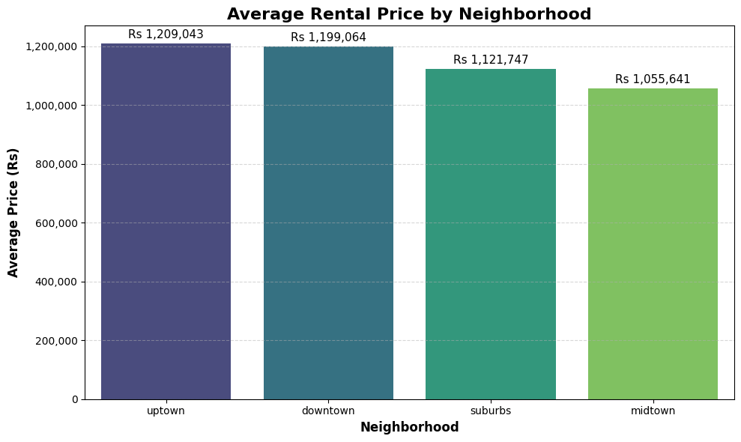
3. Explorative Data Analysis
A
B
E
3. A Understand Rental Price Trends

Slide 13
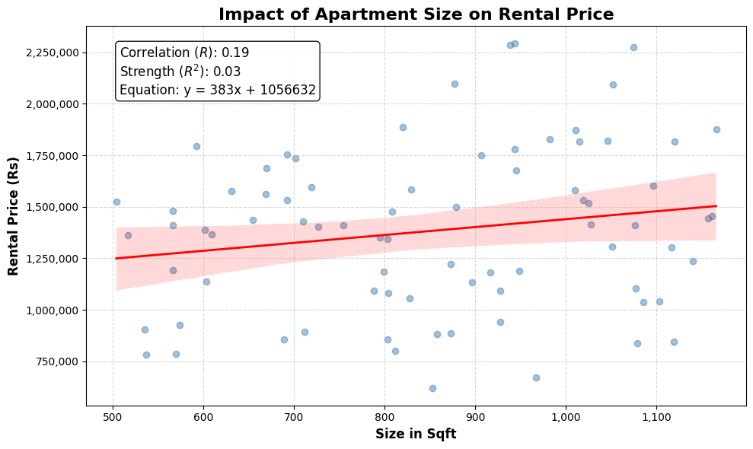
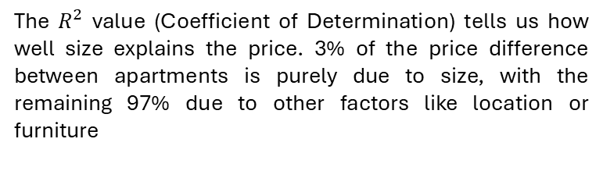
3. Explorative Data Analysis
B
A
C
3. A Understand Rental Price Trends
The chart displays a weak positive linear correlation (R≈0.19) between apartment size and rental price.
According to the regression model, the slope of the line indicates that for every additional square foot of space, the monthly rent of apartment increases by approximately Rs 383/=
The $R^{2}$ value (Coefficient of Determination) tells us how well size explains the price. 3% of the price difference between apartments is purely due to size, with the remaining 97% due to other factors like location or furniture

Slide 14
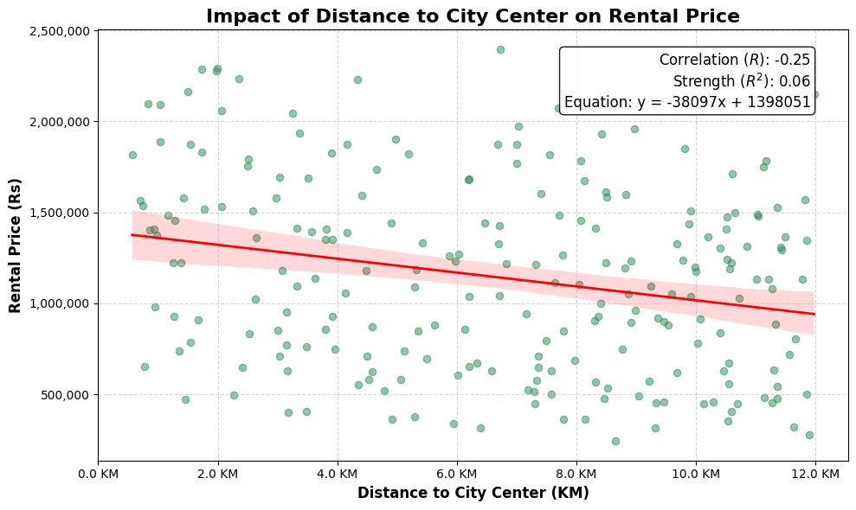
3. Explorative Data Analysis
C
D
B
3. A Understand Rental Price Trends
The chart demonstrates a clear negative linear relationship. As the distance from the city center increases, the rental price decreases
The regression slope tells us the financial value of a commute. According to the model, for every 1 km you move away from the city center, you save approximately Rs 38,000/= in monthly rent.

Slide 15
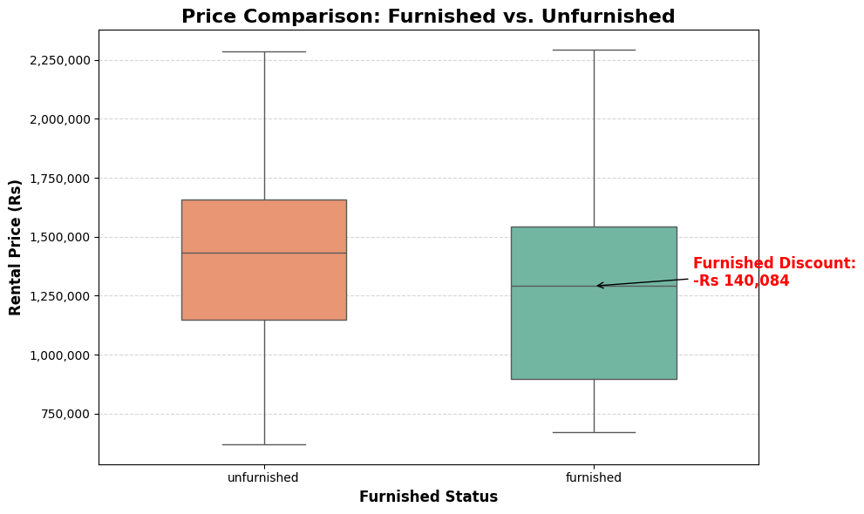
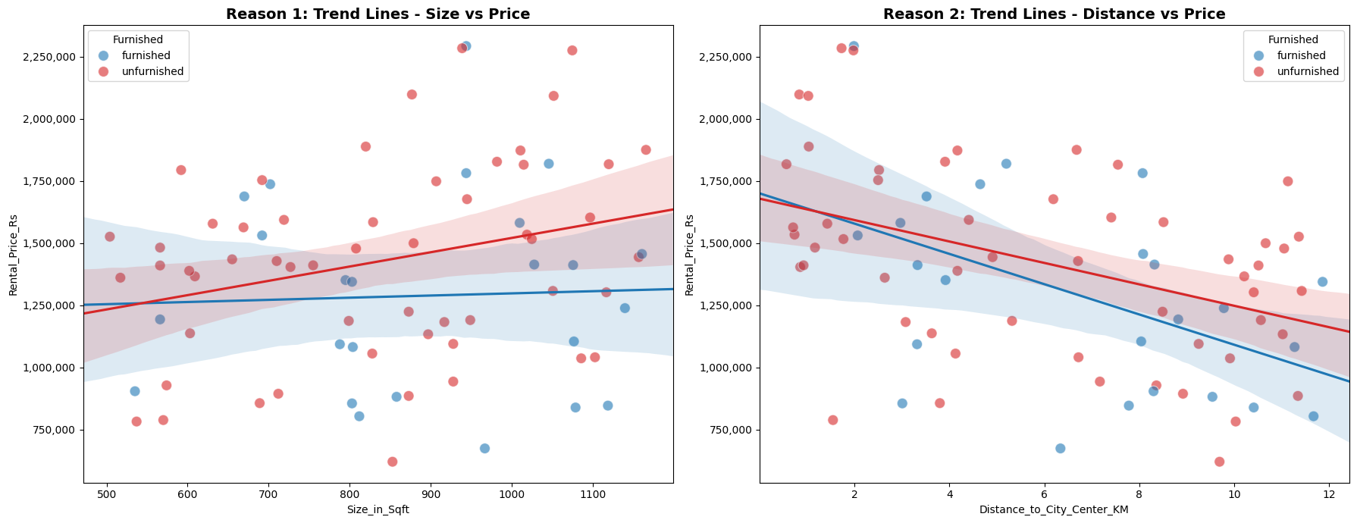
3. Explorative Data Analysis
D
C
E
3. A Understand Rental Price Trends
the boxplot reveals that Unfurnished apartments in our dataset command a significantly higher median price than Furnished ones.
Our analysis confirms a "Furnished Discount" of approximately Rs 140,000 (Median). This counter-intuitive finding suggests that the "Unfurnished" category in Colombo is dominated by larger, ultra-luxury properties where tenants prefer to bring their own interiors, whereas "Furnished" units tend to be smaller, mid-range apartments targeting short-term stays.

Slide 16
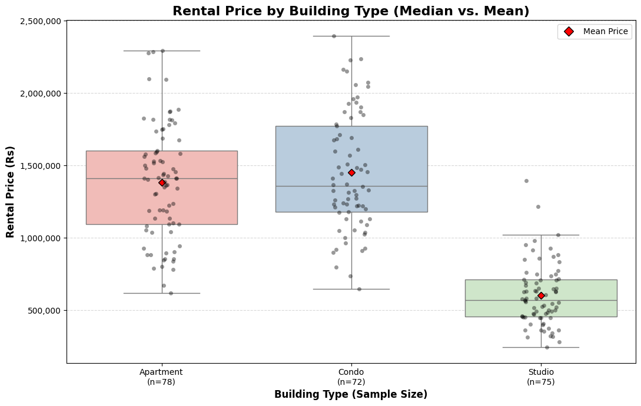
3. Explorative Data Analysis
E
D
F
3. A Understand Rental Price Trends
This chart compares pricing across building types. We added Red Diamonds to indicate the average (Mean) price, distinct from the median line.
for Condos, the Red Diamond (Mean) is slighly higher than the center line (Median). This confirms that a few ultra-expensive penthouses are pulling the average up, skewing the market perception.
The sample counts (n=...) on the x-axis show us which categories have enough data to be trusted.

Slide 17
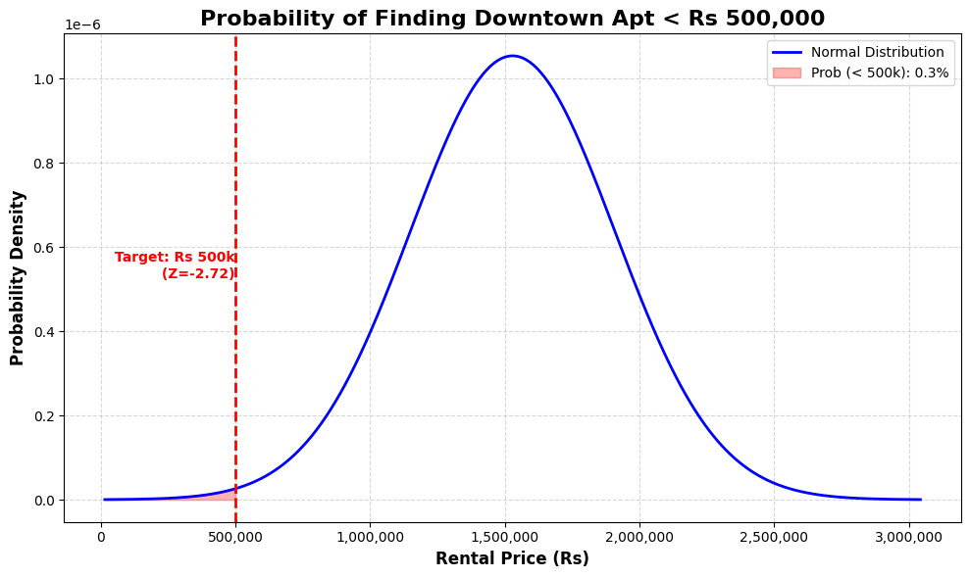
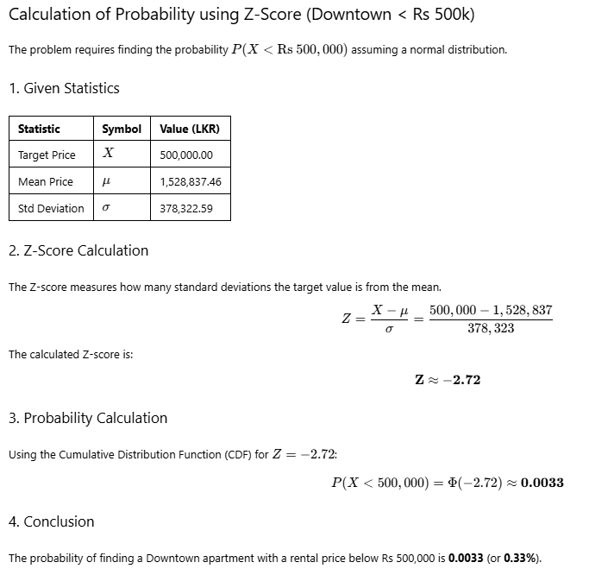
3. Explorative Data Analysis
F
A
E
3. A Understand Rental Price Trends
Using the Normal Distribution assumption, we calculated the likelihood of finding a budget-friendly unit (under Rs 500k) in the premium 'Downtown' district. The calculated Z-score is -2.72, which places this price point in the left tail of the curve

Slide 18
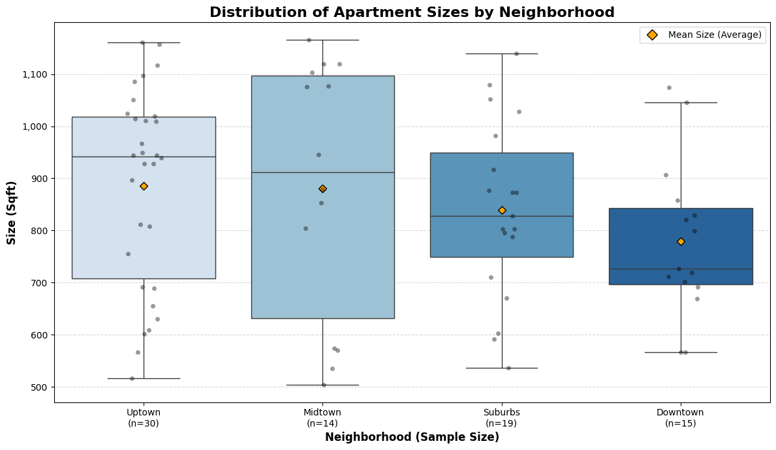
3. Explorative Data Analysis
A
F
B
3. B Apartment Features & Their Influence
Uptown and Midtown are Left-Skewed (Negatively Skewed). You can see this because the Mean (Orange Diamond) is lower than the Median line. Suburbs and Downtown are slightly Right-Skewed (Mean is higher than the Median).
Midtown shows the most diversity. It has the tallest box (largest Interquartile Range), meaning it offers a wide mix of apartment sizes, from very small (~500 sqft) to very large (~1150 sqft).
Downtown is the most standardized. It has the shortest box, indicating that most units there are very similar in size (clustered between 700 and 850 sqft).

Slide 19
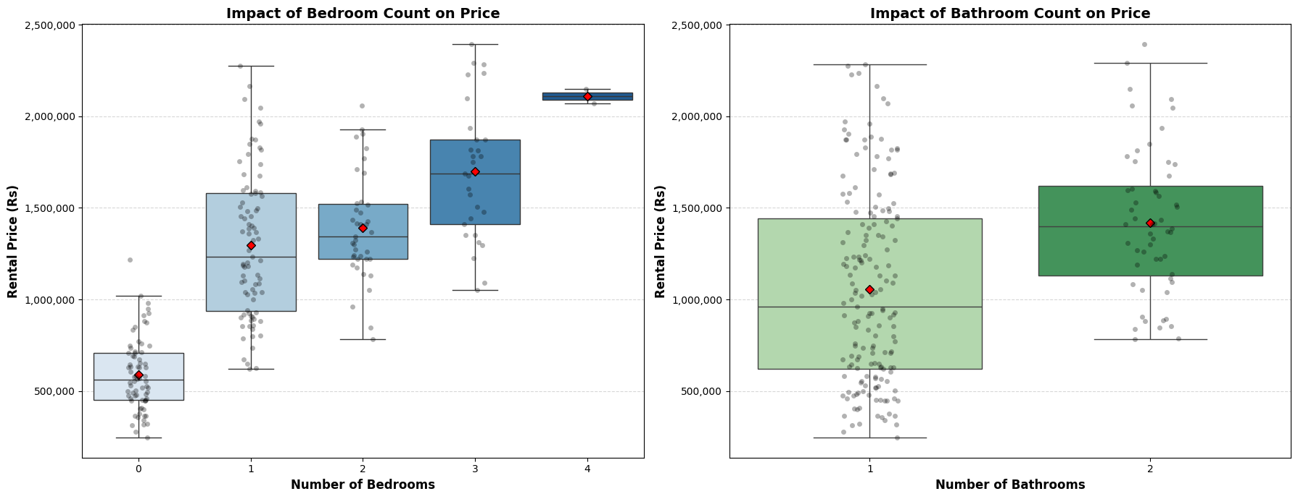
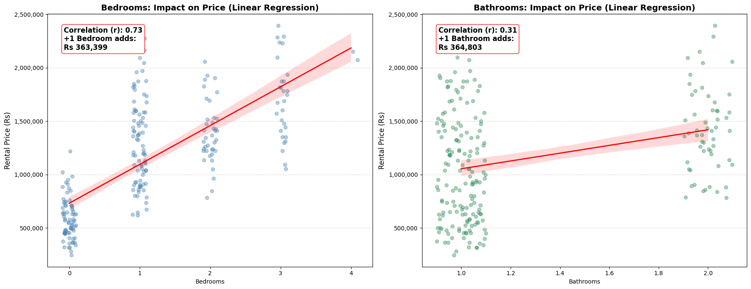
3. Explorative Data Analysis
B
A
C
3. B Apartment Features & Their Influence
Adding 1 Bedroom increases the rental price by approximately Rs 363,399 per month. (Correlation: 0.73 - Strong). Adding 1 Bathroom increases the rental price by approximately Rs 364,803 per month. (Correlation: 0.31 - Weak)
The steepest jump is Studio (0) to 1 Bedroom (mean price doubles). There is a "price plateau" between 1 and 2 Bedrooms, where the price increase is very small. The price begins to climb significantly again at 3 and 4 bedrooms.
While the potential value add is higher for bathrooms, the Correlation is low (0.31). This means simply adding a bathroom is a "riskier" bet for increasing value compared to adding a bedroom, which has a very predictable impact (0.73 correlation).

Slide 20
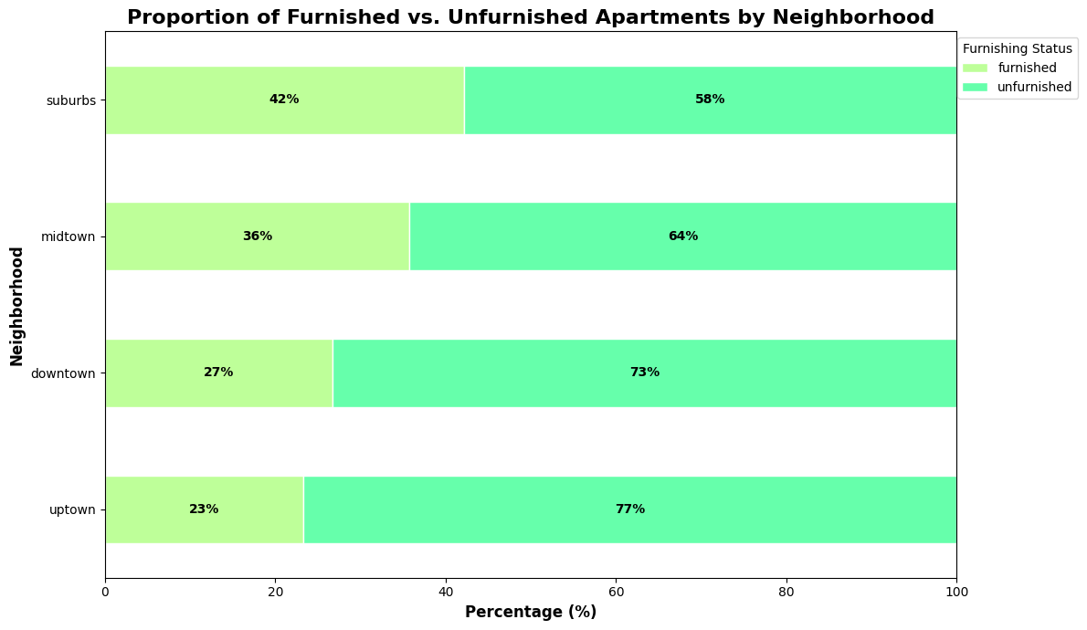
3. Explorative Data Analysis
C
B
D
3. B Apartment Features & Their Influence
Neighborhoods like Suburbs have the highest density of furnished units (42%). This suggests a more transient population of short-term renters. In contrast, Uptown is dominated by unfurnished inventory (77%). This signals a stable, long-term rental market where tenants likely prefer to settle down for years
While no neighborhood is extremely low (e.g., <10%), Uptown has the lowest supply of furnished options (23%), making it the primary candidate for a "Blue Ocean" opportunity if you wanted to introduce premium furnished units.

Slide 21
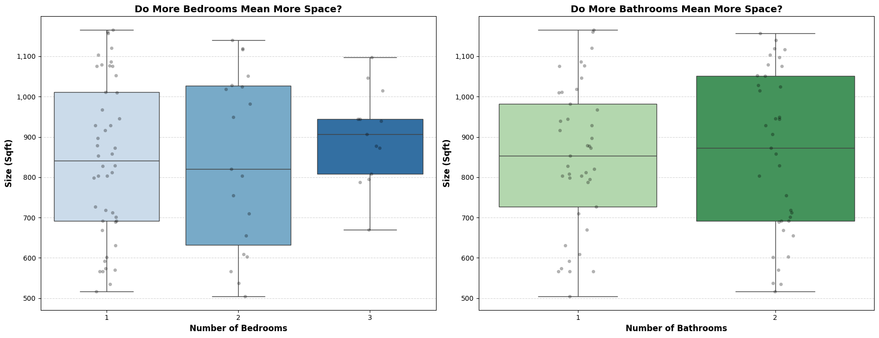
3. Explorative Data Analysis
D
C
A
3. B Apartment Features & Their Influence
The data proves that a higher bedroom count does not guarantee a larger apartment. The fact that 2-bedroom units have a lower median size (~820 sq ft) than 1-bedroom units (~850 sq ft) suggests that developers are likely partitioning standard-sized units into smaller rooms to market them as "2-bedroom" apartments. Bathrooms are a more reliable proxy for size. Unlike bedrooms, an increase in bathroom count consistently correlates with an increase in total square footage.
3-Bedroom apartments do have the highest median size (around 900+ sq ft) and the tightest range of sizes. There is a massive overlap in 1-2 Bedroom. Surprisingly, the median size for the 2-bedroom group (approx. 820 sq ft) appears slightly lower than the 1-bedroom group (approx. 850 sq ft) in this specific dataset.
A Consistent Indicator There is a visible trend where apartments with 2 bathrooms generally have a higher median size (around 875 sq ft) compared to those with 1 bathroom (around 850 sq ft). The distribution for 2 bathrooms sits slightly higher, indicating that adding a bathroom correlates with more square footage.

Slide 22
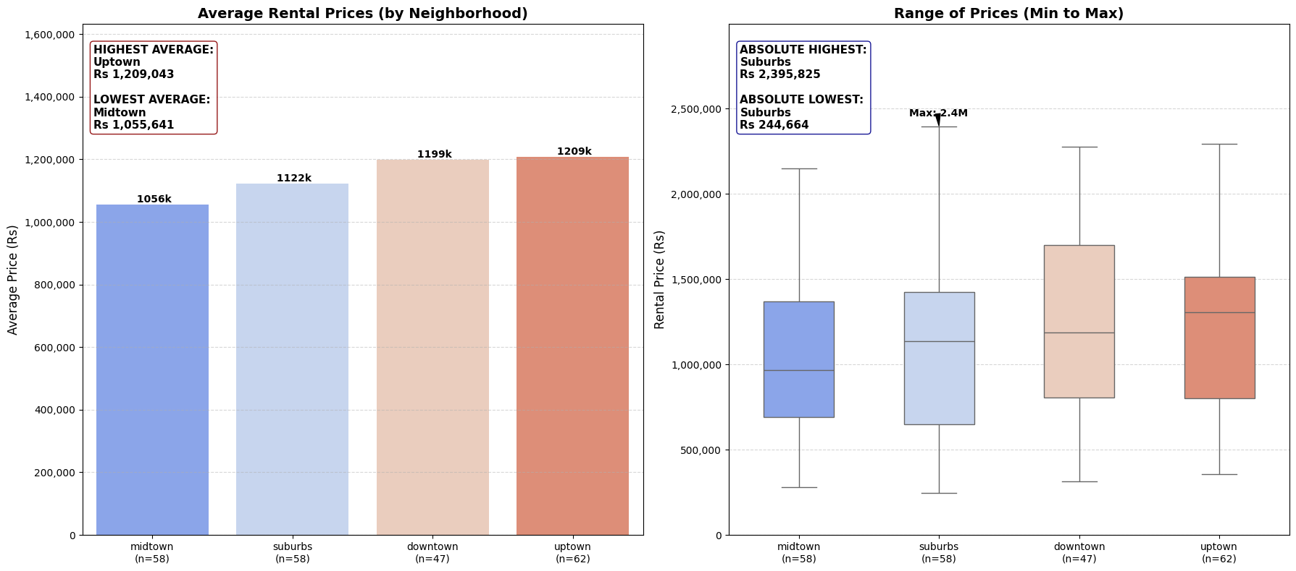
3. Explorative Data Analysis
A
D
B
3. C Neighborhood Comparison
Invest in Suburbs for growth. The massive gap between the lowest (Rs 244k) and highest (Rs 2.4M) prices suggests you can buy cheap, undervalued units and renovate them to capture that top-tier rent.
Invest in Midtown for volume. As the lowest-cost market (avg Rs 1.05M), it allows you to buy multiple units for the price of one luxury unit elsewhere, diversifying risk.
Uptown takes the top spot with an average rent of Rs 1,209,043, positioning it as the steady premium market. Midtown is the most affordable on average, sitting at Rs 1,055,641. While Suburbs average is in the middle, they contain both the single most expensive (Rs 2.4M) and single cheapest (Rs 244k) apartments in the entire dataset.

Slide 23
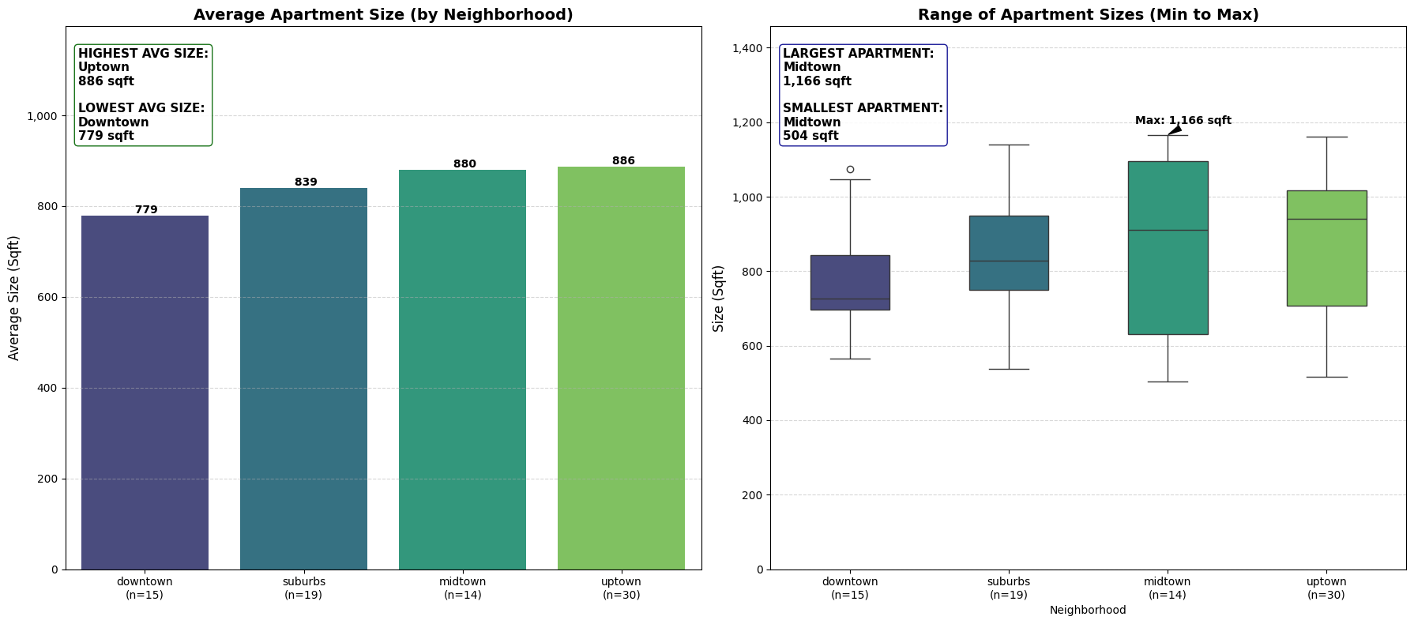
3. Explorative Data Analysis
B
A
C
3. C Neighborhood Comparison
For Stability & Premium Rents, Invest in Uptown. The data shows a consistent inventory of large square footage, making it the safest bet for attracting families or long-term tenants seeking space.
For High-Risk/High-Reward, Target Midtown. The extreme variance suggests a mixed-stock neighborhood. carefully selecting the larger units that are undervalued or avoiding the micro-units that drag down the median value.
Uptown Offers the most spacious living on average at 886 sqft, with a solid sample size (n=30), indicating consistent availability of larger units. Downtown Averages the smallest size at 779 sqft. The box plot shows a tight range, meaning units here are predictably smaller. Midtown Shows the highest volatility. While the average is high (880 sqft), it has the widest range, containing both the single largest (1,166 sqft) and smallest (504 sqft) apartments in the dataset.

Slide 24
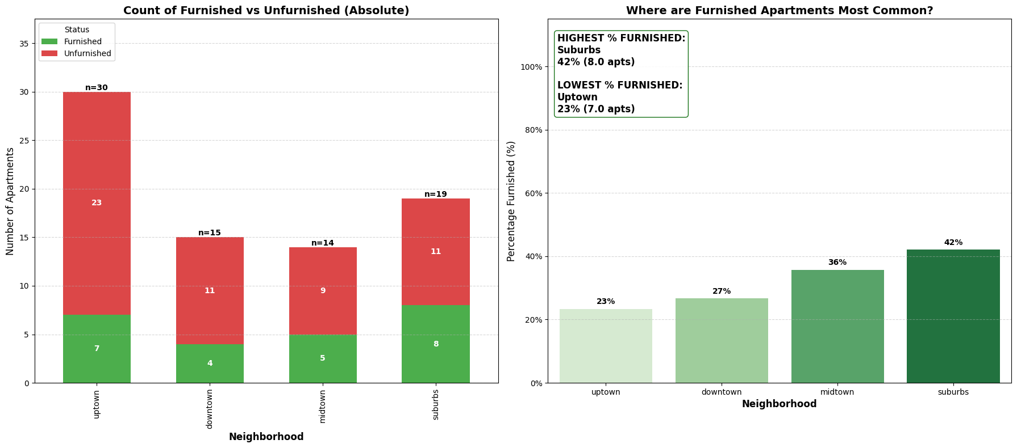
3. Explorative Data Analysis
C
B
A
3. C Neighborhood Comparison
For Short-Term/Corporate Housing, Focus on Suburbs and Midtown. The data indicates a proven market demand for move-in-ready spaces, likely driven by transient tenants or business travelers.
For Niche Differentiation, Consider furnishing a unit in Uptown. Since nearly 80% of the market is unfurnished, a stylish, furnished apartment here faces very little direct competition and could command a premium from specific renters.
Suburbs, This neighborhood has the highest density of furnished apartments at 42%, nearly double the rate of some other areas. Midtown Also shows a significant preference for furnished units at 36%. Despite having the highest total number of apartments (30), it has the lowest percentage of furnished options (23%), meaning the vast majority of inventory here is unfurnished.

Slide 25
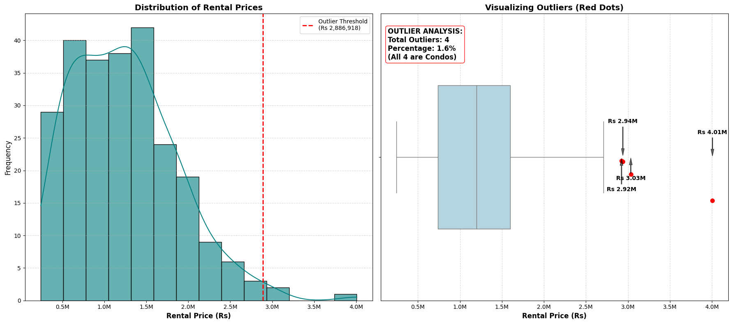
3. Explorative Data Analysis
A
C
B
3. D Market Dynamics & Outliers
Any rent above Rs 2,886,918 is considered an outlier in this dataset. The four outlier properties are priced at Rs 2.92M, Rs 2.94M, Rs 3.03M, and Rs 4.01M. All four of these high-priced outliers are identified as Condos, suggesting that luxury condominiums are driving the extreme upper end of the rental market.

Slide 26
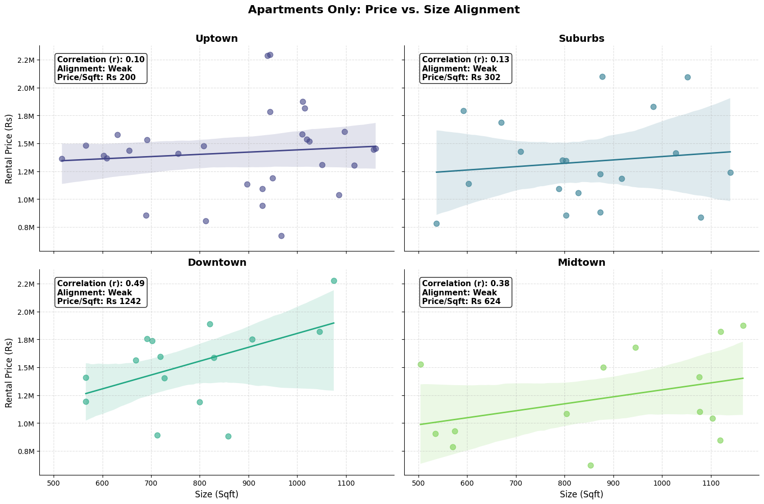
3. Explorative Data Analysis
B
A
C
3. D Market Dynamics & Outliers
Uptown (r = 0.10) & Suburbs (r = 0.13) neighborhoods show almost no correlation between size and price. The trend lines are nearly flat, meaning a tiny apartment can cost just as much as a huge one. Downtown (r = 0.49) Shows the strongest alignment but still weak correlation. Generally, as size goes up, price goes up here, likely due to the extremely high price per sqft (Rs 1,242).
Since the market here doesn't efficiently price space, look for arbitrage opportunities. Large apartments that are underpriced simply because the market isn't strictly paying for size. You can likely find massive units for the same price as small ones. In these neighborhoods, adding square footage won't necessarily increase rental yield. Instead, invest capital in interior upgrades, furnishings, or modern amenities, as these subjective factors are likely what is actually driving the price variance.

Slide 27
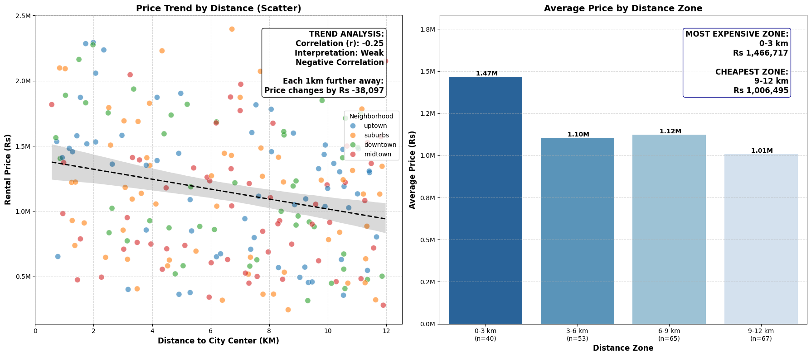
3. Explorative Data Analysis
C
B
A
3. D Market Dynamics & Outliers
Zone (3-6 km) area represents the "sweet spot" for value-driven tenants. It offers a massive discount compared to the city center (saving ~Rs 370k/month) without the long commute of the outer suburbs. It is likely the easiest zone to market.
6-9 km zone appears to be a "dead zone" for value. It is actually slightly more expensive on average than the closer 3-6 km zone. Unless a property here has unique amenities, it will be hard to compete with closer properties that cost the same.
There is a clear trend, Rental prices generally decrease as you move further away from the city center. The data shows a "negative correlation" (r=−0.25), meaning distance acts as a discount factor. Specifically, for every additional kilometer a tenant moves away from the center, the rent drops by approximately Rs 38,097 on average. The price drop is steepest immediately after the city center. The 0-3 km zone is the most expensive (Rs 1.47M), while the 9-12 km zone is the cheapest (Rs 1.01M). However, prices flatten out in the middle (3-9 km), showing little difference in that range.

Slide 28
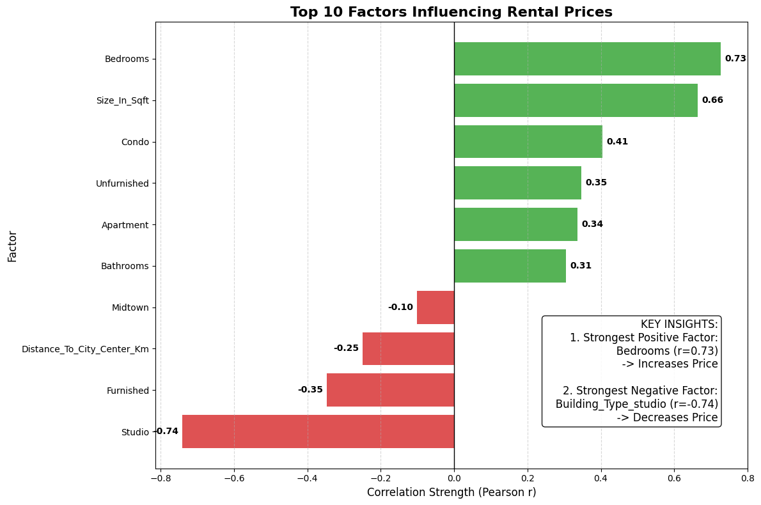
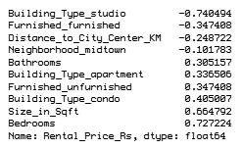
3. Explorative Data Analysis
A
C
B
3. D Correlation & Patterns
Since bedrooms drive value more than raw size, renovation budget is best spent creating distinct rooms. If you have a large open layout, adding a wall to create an extra bedroom will likely yield a higher ROI than leaving it as a massive studio or 1-bedroom.
Don't automatically spend capital on furniture to boost rent. The data shows the premium market prefers unfurnished spaces. Save that budget for structural improvements or amenities that attract long-term tenants who bring their own furniture.
The strongest driver of higher rent is the Number of Bedrooms (r=0.73). It actually outweighs total square footage (r=0.66), meaning tenants value distinct rooms more than just open space. The single biggest "price killer" is being a Studio (r=−0.74). This factor drags rental prices down more than any other variable. Interestingly, Unfurnished apartments correlate with higher prices (r=0.35), while Furnished units correlate with lower prices (r=−0.35). This suggests that the most expensive listings (luxury condos/family homes) are typically rented unfurnished, while cheaper, smaller units come furnished.

Slide 29
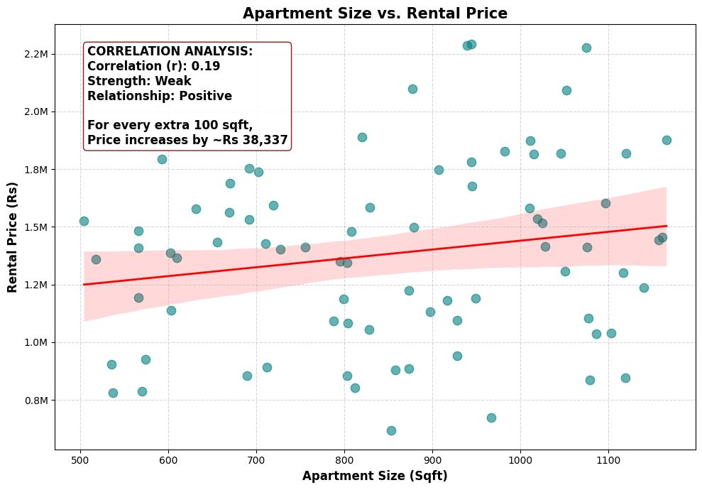
3. Explorative Data Analysis
B
A
C
3. D Correlation & Patterns
Weak Positive Correlation (r=0.19),There is a link between size and price, but it is surprisingly weak. While larger apartments generally cost more, size alone is not a reliable predictor of rent. On average, for every additional 100 sqft of space, the rental price increases by approximately Rs 38,337. The data points are widely scattered, meaning you can find small apartments that are very expensive and large apartments that are relatively cheap.
Since the market doesn't place a high premium on raw size (weak alignment), do not simply buy the largest property available hoping for the highest rent. A smaller, well-designed apartment (e.g., a well-laid-out 2-bedroom) will likely yield a better return on investment than a large, poorly laid-out unit, as tenants are paying for utility (rooms/amenities) rather than just floor space.

Slide 30
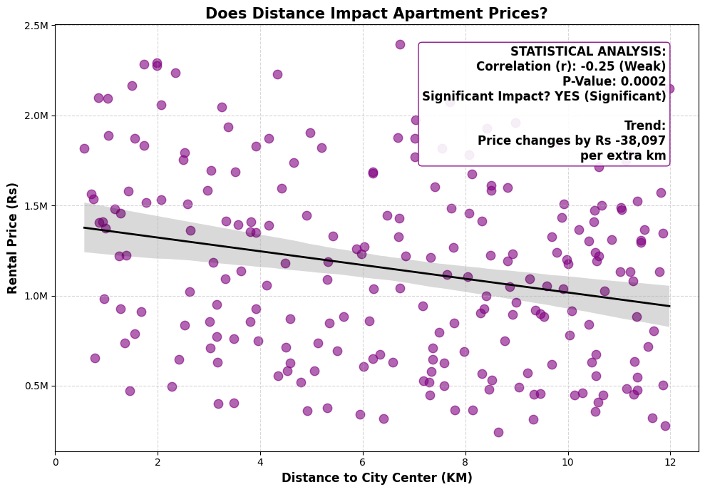
3. Explorative Data Analysis
C
1
B
3. D Correlation & Patterns
It is Significant, The analysis explicitly confirms the impact is statistically significant (P-Value: 0.0002). The relationship is not random. On average, rental prices drop by Rs 38,097 for every single kilometer you move away from the city center.

Slide 31
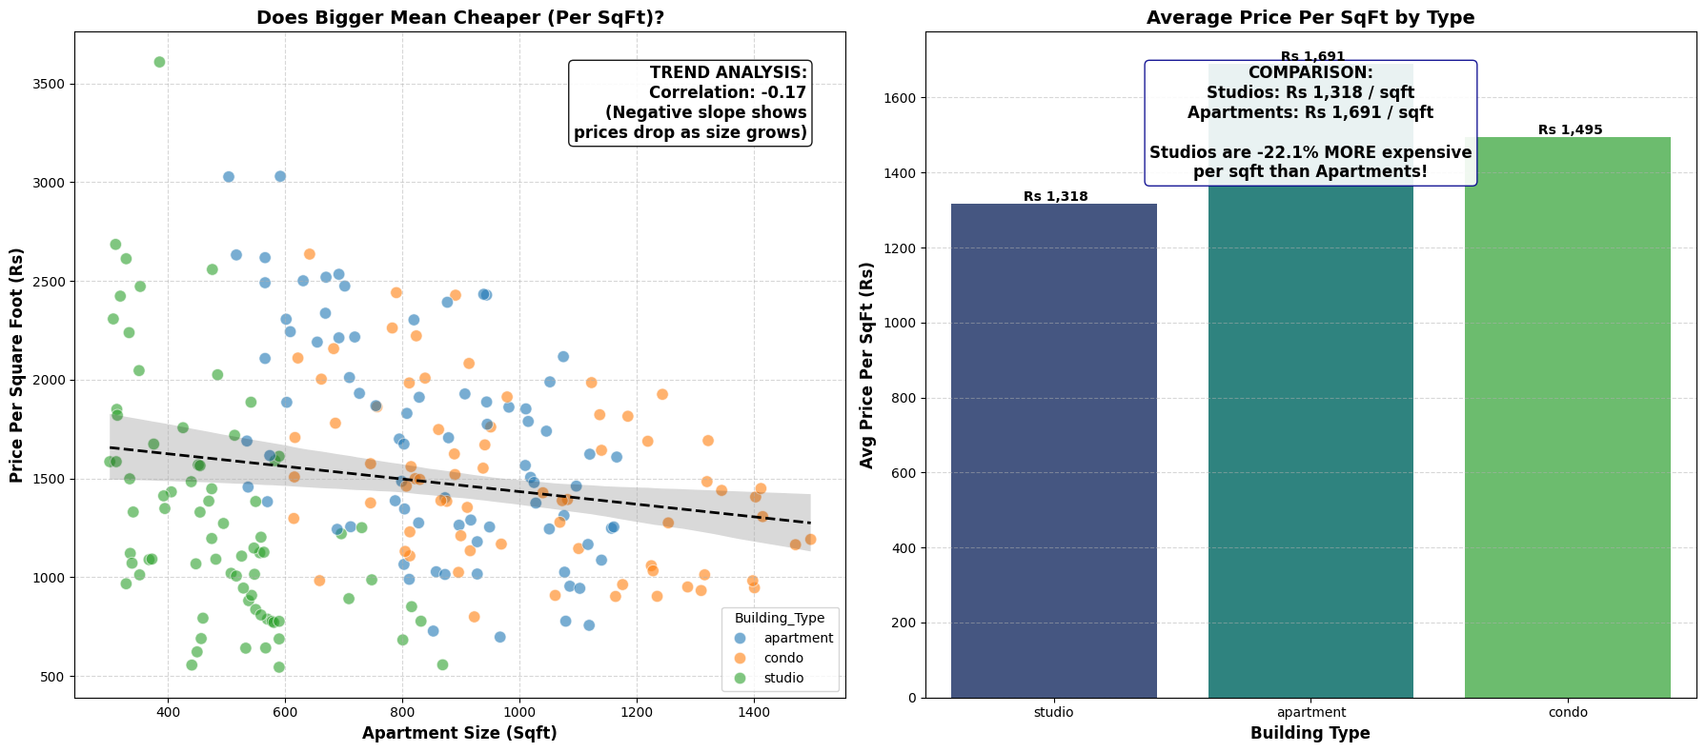
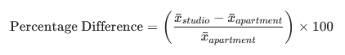
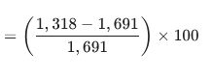
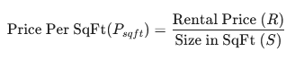
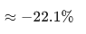
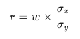
3. Explorative Data Analysis
1
2
c
3. F Hypotheses
"I hypothesize that smaller Building(like studio) actually cost more per square foot than larger apartments. While you pay less total rent for a small place, you pay a 'premium' for every square foot of space compared to the 'bulk discount' you get with a larger unit."
ACCEPTED
Strategic Investment Decision
Avoid purchasing massive, single-family apartments (e.g., 2,000 sqft) for rental purposes. Instead, prioritize acquiring multiple smaller units or subdividing large properties. Since the market pays a higher rate per sqft for smaller spaces, your total rental income will be significantly higher from two 800 sqft units than from one 1,600 sqft unit. You maximize ROI by selling "utility" rather than just "bulk space."
Slope/Weight
Apartment Size(sqft)
The scatter plot confirms a negative correlation (-0.17). The trend line slopes downward, meaning as apartment size increases, the price per square foot decreases. This validates that the market charges a premium for "efficiency." Tenants pay a higher rate for every square foot in a compact space compared to the "bulk discount" they get with a massive unit.
Intercept/Bias
Correlation
Coefficient
Standard Deviations [x,y]

Slide 32
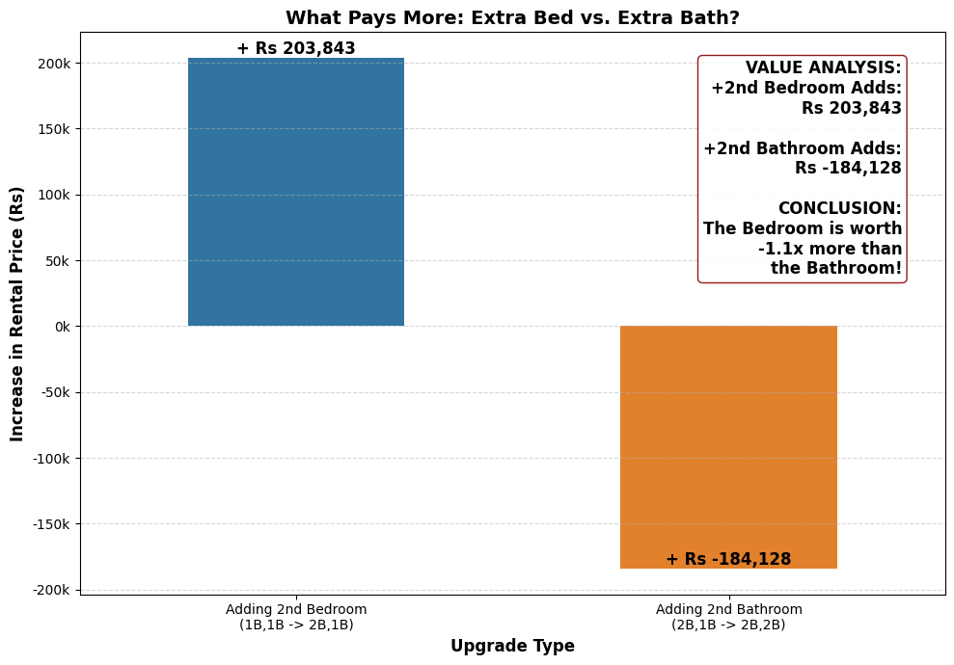
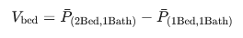
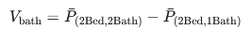
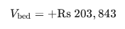
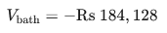

3. Explorative Data Analysis
2
3
1
3. F Hypotheses
"I hypothesize that adding a second bathroom adds more value to a rental property than adding a second bedroom. While bedrooms add essential space, a second bathroom is considered a 'luxury' convenience that commands a higher premium."
REJECTED
Strategic Investment Decision
If you have extra square footage during a renovation, build a bedroom, not a bathroom. A 2-bedroom/1-bath unit will consistently rent for significantly more than a 1-bedroom/2-bath unit. Capital spent on plumbing for an extra toilet yields a negative ROI, whereas dry-walling a new room boosts yield immediately.
The bathroom isn't destroying value. Rather, the types of apartments that have 2 bathrooms in data set happen to be cheaper (likely due to location or furnishing) than the types that have 1 bathroom.
Adding a second bedroom increases the rental price by Rs 203,843. Surprisingly, adding a second bathroom actually correlates with a decrease in rent of Rs 184,128. The market values "sleeping space" (utility) far more than "convenience." A 2nd bedroom is a revenue generator; a 2nd bathroom is a cost center that tenants aren't willing to pay extra for.

Slide 33





3. Explorative Data Analysis
3
2
3. F Hypotheses
"I hypothesized that while Unfurnished apartments have higher total rents (likely due to being larger), Furnished apartments would command a higher 'Price Per Square Foot' due to the added value of furniture and convenience."
REJECTED
Strategic Investment Decision
Stop allocating budget towards furnishing rental units. Rent them Unfurnished. The data proves that the "premium" tenants (who pay more total and more per sqft) prefer empty spaces they can customize. Furnishing a unit places it into a "discount" category (saving tenants ~21% per sqft), effectively lowering potential ROI.
As hypothesized, Unfurnished units rent for significantly more in total (Rs 1.40M) compared to Furnished units (Rs 1.02M). Contrary to the hypothesis, Unfurnished units also command a higher price per square foot (Rs 1,748) compared to Furnished units (Rs 1,379). This suggests that the highest-quality inventory (likely luxury condos) is rented unfurnished, while furnished inventory consists of lower-tier or budget housing. Furnishing a unit in this market actually correlates with lower value density.

Slide 34
3
THANK YOU

